Slide 1
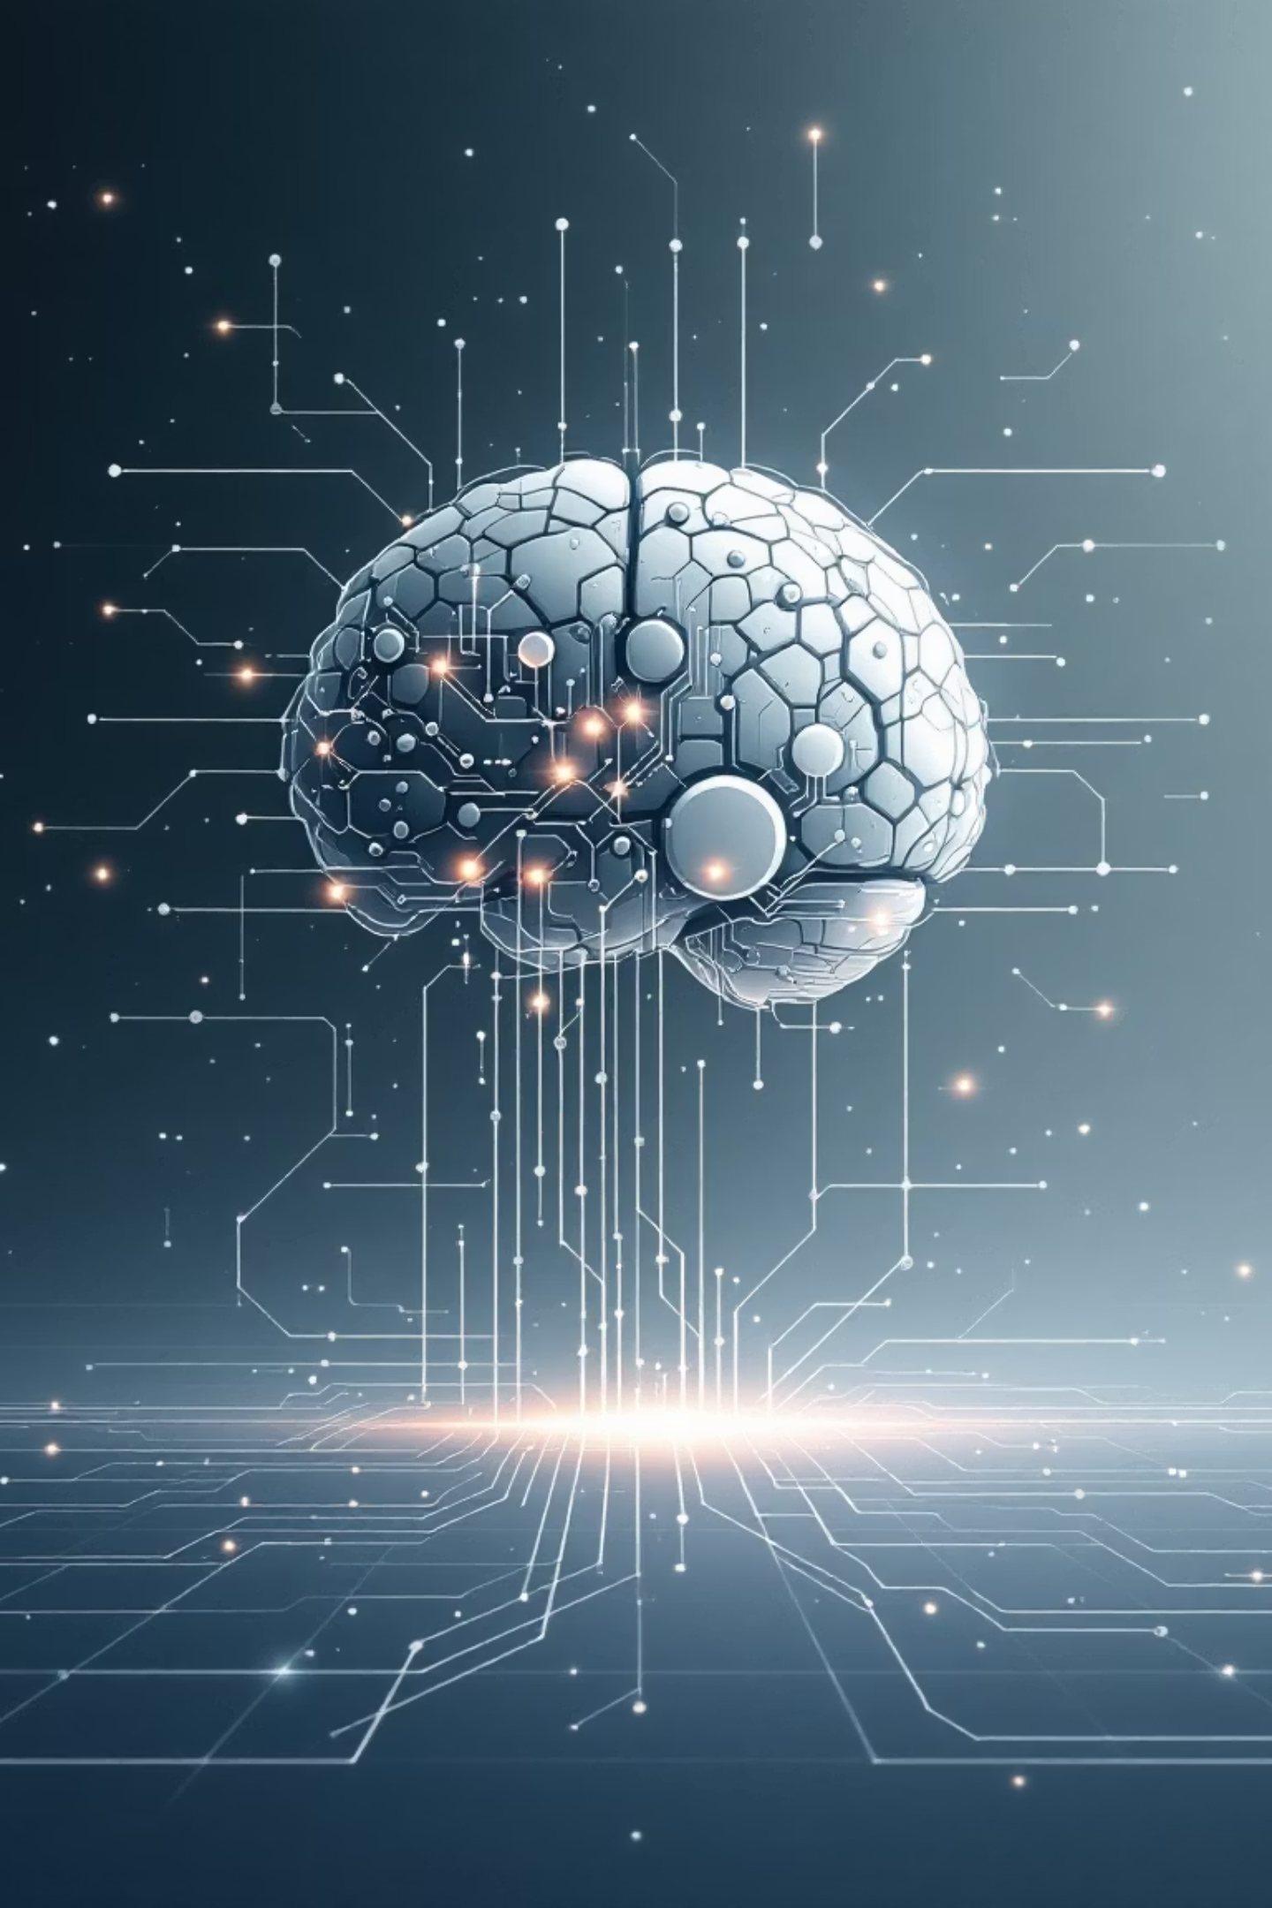
AI-Powered Story Generator
An AI tool that turns your imagination into story text and visual illustrations
Submitted by: Rupam Priya
Reg id:12200791
Supervised by: Dr. Ridhi Kapoor.

Slide 2
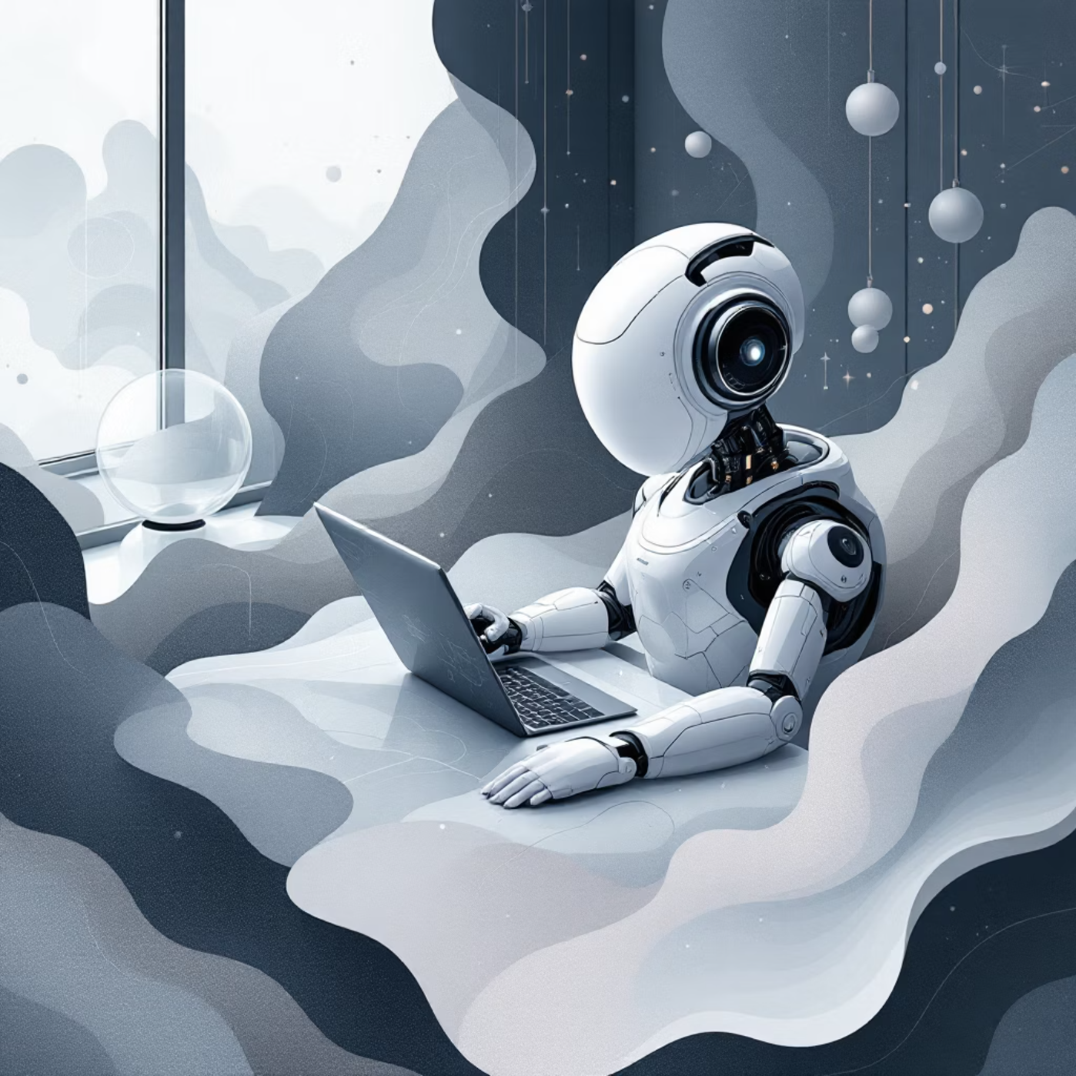
Revolutionising Storytelling with AI
.
Traditionally, crafting compelling narratives demands significant time, creativity, and artistic skills for illustrations. This AI-powered solution simplifies story creation by converting a brief idea into a multi-scene story complete with vivid illustrations.
Our AI Story Generator helps students, teachers, writers, and content creators to bring their imaginative concepts to life effortlessly.

Slide 3

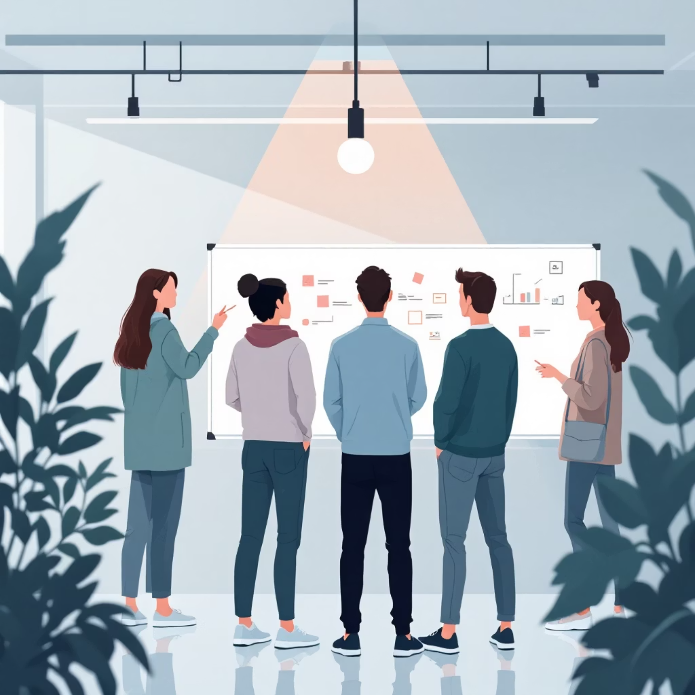
Addressing the Challenges of Creative Production
Story writing can be an incredibly time-consuming endeavour, often leading to creative blocks. Moreover, producing high-quality illustrations typically requires engaging professional artists, which can be costly and time-intensive.
Students frequently struggle to visualise complex ideas, hindering their learning and presentation capabilities. There is a clear need for fast, automated, and creative tools to overcome these hurdles.
Our innovative solution offers an AI-based system for both storytelling and image generation, streamlining the entire creative process.

Slide 4
Primary Project Objectives
Automated Story Generation
Scene-wise Illustrations
Maintain Story Flow
To create compelling, scene-specific illustrations using advanced text-to-image models.
To ensure a logical narrative progression, covering introduction, conflict, climax, and a satisfying ending.
To auto-generate a complete, coherent story from a simple 1–2 line prompt.
User-Friendly Interface
Seamless Integration
To build an intuitive and simple interface for seamless user interaction.
To integrate text and image generation into a single, cohesive workflow.

Slide 5





Secondary Project Objectives
Customisation Options
Regeneration Features
Export Capabilities
Provide flexibility for users to select genre, tone, and artistic style.
Allow users to regenerate stories or images for desired outcomes.
Enable easy PDF export of stories and individual image downloads.
Full-Stack Implementation
Future Expansion
Demonstrate a robust full-stack AI system.
Lay groundwork for features like text-to-speech, animation, and multilingual support.

Slide 6
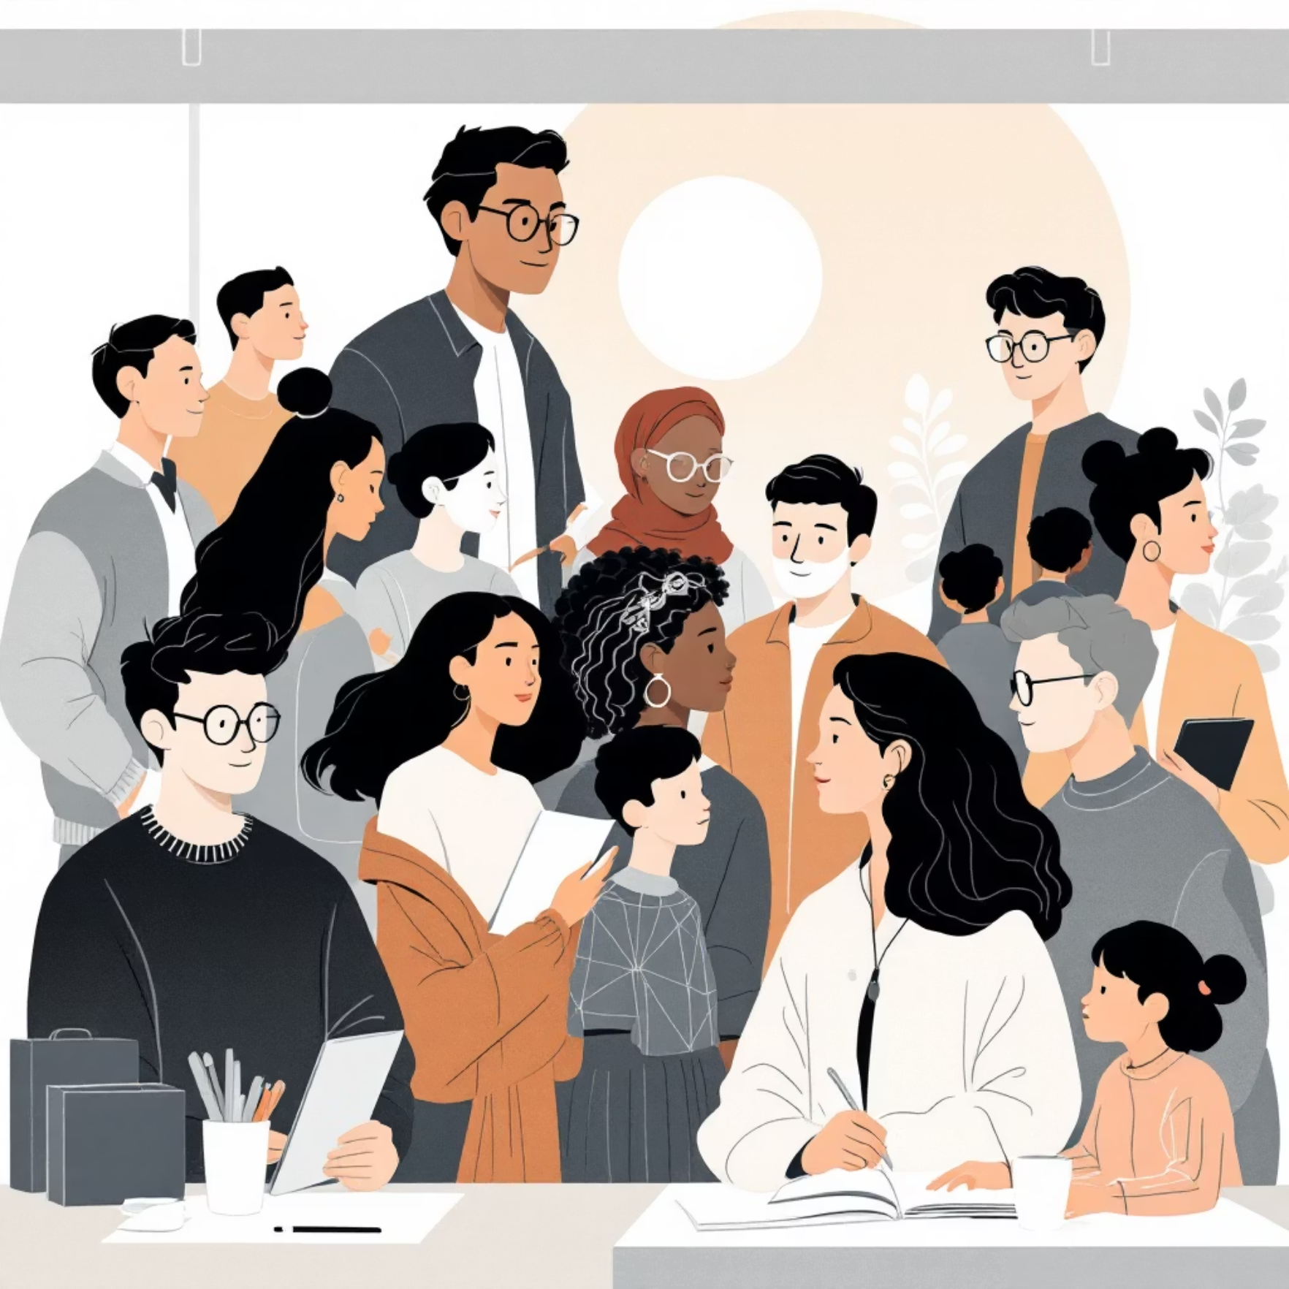

Broadening the Scope of Creative Possibilities
Target Audiences
Versatile Applications
Students: For educational projects and creative writing.
Education: Enhancing learning and engagement.
Teachers: To create engaging lesson materials.
Digital Content Creation: Streamlining production workflows.
Content Creators: For rapid content generation.
Storyboarding: Visualising narratives for film or animation.
Writers: As a tool for brainstorming and drafting.
Creative Projects: Supporting diverse artistic endeavours.
Kids: To foster imagination and early literacy.
The project can be extended to include voice narration, animations, cloud storage integration, and dedicated mobile applications, offering even greater utility and accessibility.

Slide 7
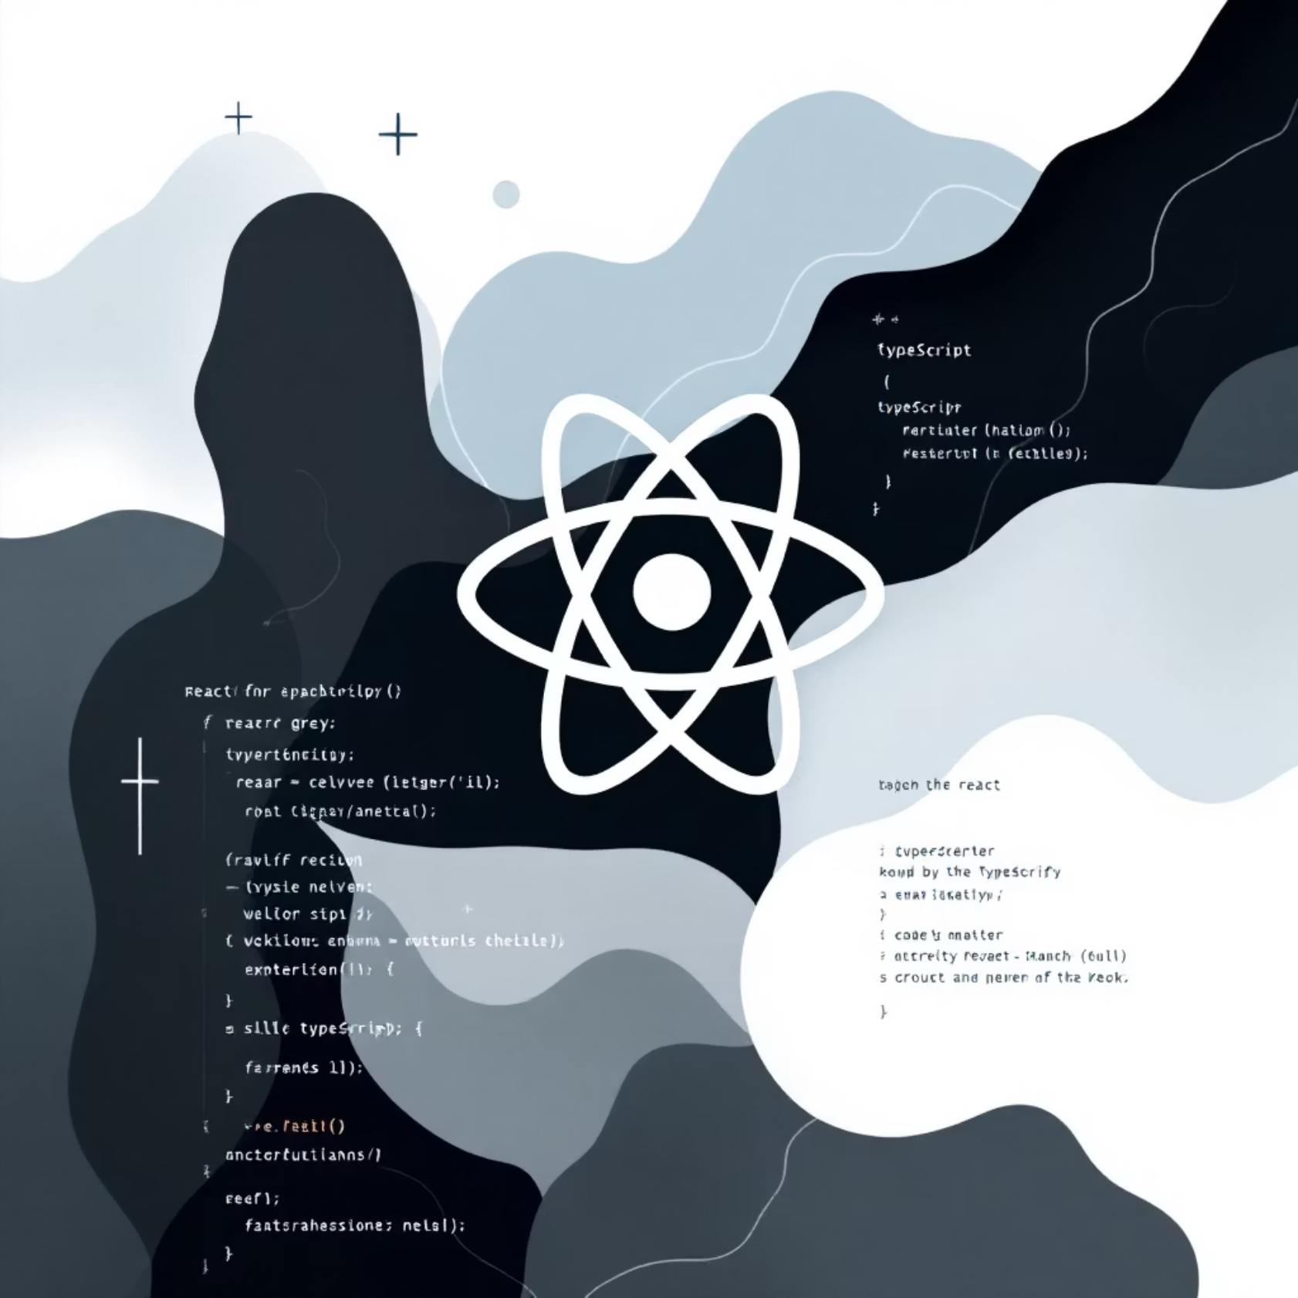
Frontend Technologies: Crafting the User Experience
React (TypeScript)
The frontend is built using React with TypeScript, ensuring a robust and scalable user interface.
UI Components
Key components include Sliders, Tabs, Switches, Textareas, and Toast notifications, designed for seamless interaction.
Responsive Design
The interface is fully responsive, providing an optimal experience across all devices, from desktops to mobile phones.
Custom Hooks
Leveraging custom hooks like useImageGeneration and use-toast for efficient logic management and state handling.

Slide 8
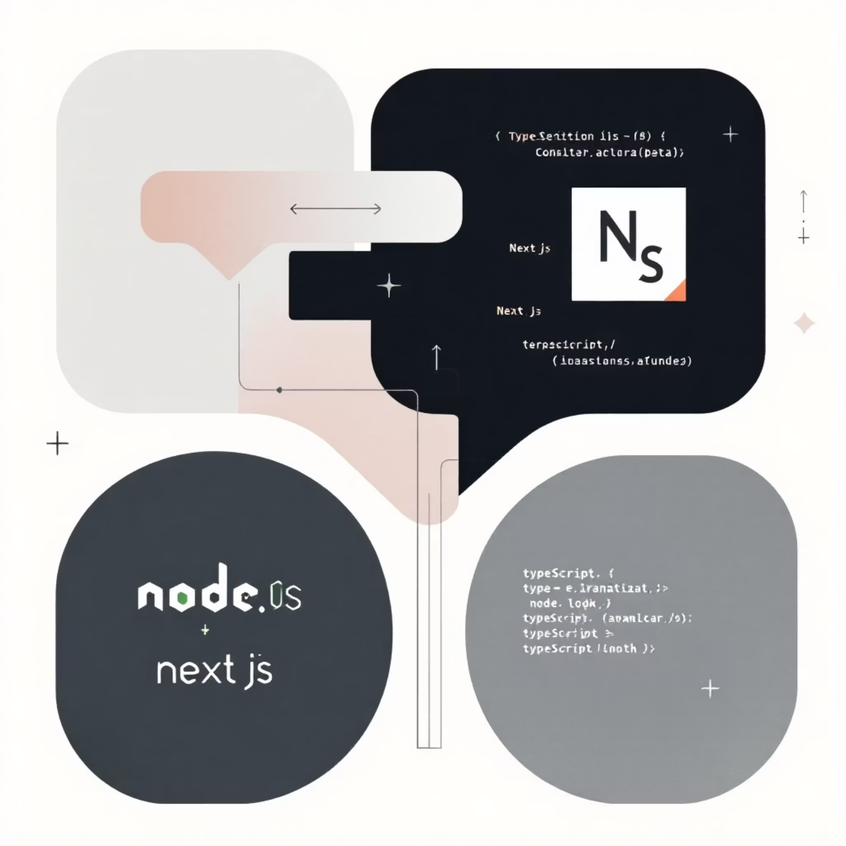
Backend Technologies: Powering the AI Engine
Next.js API Routes
The backend is powered by Next.js API Routes, offering a secure and efficient way to handle server-side logic.
Node.js + TypeScript
Built with Node.js and TypeScript, ensuring strong typing and maintainability for the server-side architecture.
API Structure
The API includes dedicated endpoints such as /api/image-generation and a planned /api/story-generation for structured interaction.
Secure Communication
This setup guarantees secure and reliable communication with external AI models, protecting data integrity and performance.

Slide 9


Advanced AI Integration: Technical Aspects
Text Generation Models
Image Generation Models
Key Tasks Performed
Utilises advanced models like GPT-4 / GPT-5, LLaMA, Mistral, and Claude for sophisticated narrative creation.
Includes scene extraction, prompt engineering, dynamic story flow generation, and the creation of high-quality illustrations.
Integrates cutting-edge models such as DALL·E, Stable Diffusion, and Midjourney API for high-quality visuals.

Slide 10






System Workflow: From Idea to Illustrated Story
User Input
The process begins with the user entering a brief story idea.
NLG Model
The Natural Language Generation (NLG) model crafts a 4-scene story.
Visual Cues
Key visual cues are extracted from the generated text.
Image Creation
An advanced image generation model then creates corresponding illustrations.
Frontend Display
The frontend displays the complete story alongside its vivid images.
Regenerate or Export
Users have the option to regenerate content or export their creations.

Slide 11

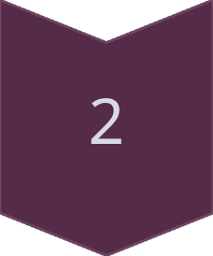
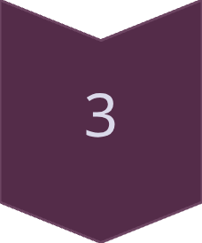
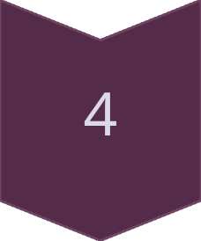

AI-Powered Text-to-Image Story Generator: Architecture Overview
The AI Story Generator leverages a sophisticated architecture to transform text prompts into rich, illustrated narratives. This report summarises the core components and their interactions, demonstrating the seamless flow from user input to the final, creative output.
Frontend (React UI)
Intuitive user interface for inputting story prompts and preferences.
Backend API Routes
Manages requests and orchestrates communication between the frontend and AI services.
AI Models
Integrates natural language generation (NLG) and advanced image synthesis (GPT + Image Generator).
Output Assembly
Combines generated story text and corresponding images into a cohesive narrative.
Final Illustrated Story
Delivers the complete, visually rich story to the user.

Slide 12






Key Features of the AI Story Generator
The AI Story Generator is designed with a suite of powerful features to enhance the creative process, offering both automation and extensive customisation. The system aims to provide a flexible and user-friendly experience for all creative needs.
Automatic Story Creation
Scene-wise Image Generation
Generates compelling narratives from simple prompts, saving time and sparking inspiration.
Creates relevant images for each scene, ensuring visual coherence with the storyline.
Multiple Art Styles
Editable & Customizable
Offers a diverse range of artistic styles to match the tone and theme of any story.
Provides tools for users to refine text, swap images, and adjust layouts to their preference.
Export Options
Easy-to-Use Interface
Allows easy export of stories as professional PDFs or engaging image galleries.
Ensures a smooth and intuitive user experience from start to finish.

Slide 13



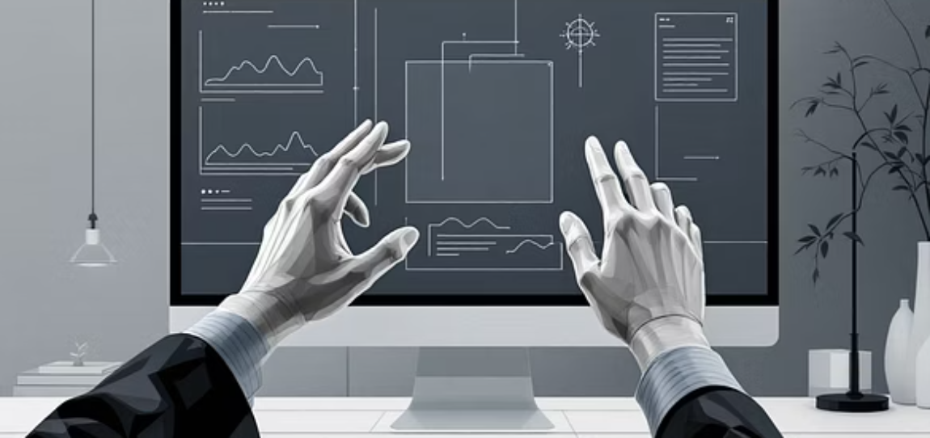
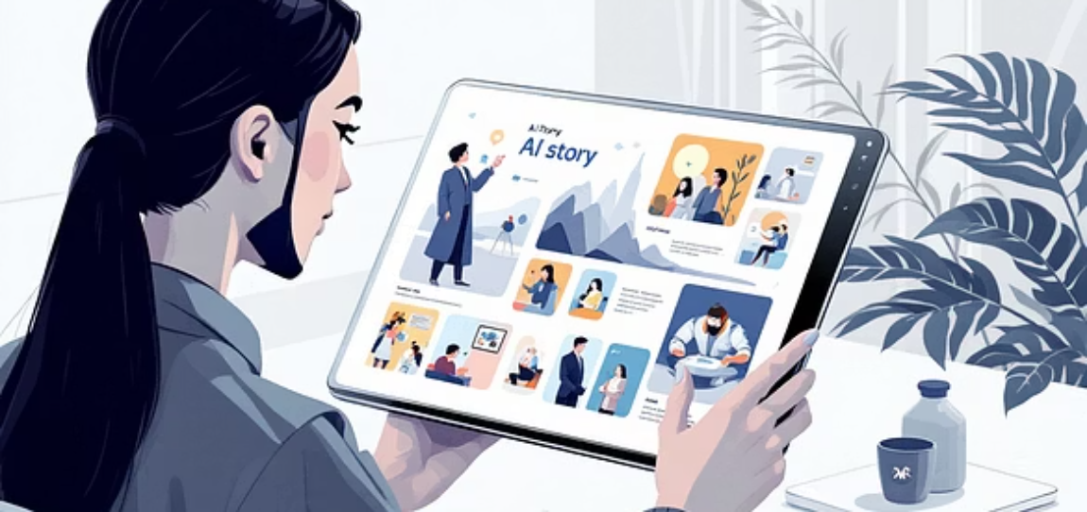
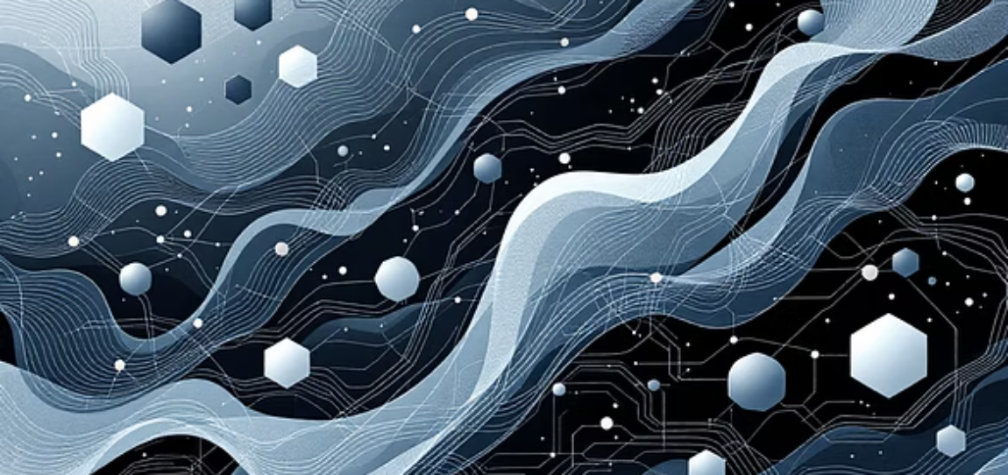
Conclusion: The Future of Storytelling with AI
The AI-powered Text-to-Image Story Generator represents a significant leap in creative technology, making sophisticated storytelling tools accessible to a broader audience. It seamlessly integrates advanced AI capabilities to unlock new possibilities in content creation.
Fast & Creative
Hybrid Technology
Versatile Tool
AI accelerates story generation, fostering creativity and innovation.
Combines Natural Language Generation with Text-to-Image models for rich output.
Ideal for educational content, creative writing, and digital media industries.
The potential for expansion is vast, paving the way for more immersive and interactive narrative experiences. We foresee future developments including voice narration, animation, and multi-lingual support, further enhancing its utility.

